Slide 1
Employees & Employment Trends MPU 3362
Developing Self Images and Self Brands
H 30

Slide 2
CLASS RULES
PLEASE BE PUNCTUAL
For online classes, you must ‘on’ the audio & camera whenever you speak
When you are not speaking, please mute your audio and off the camera.
Please use the chat option to communicate with lecturer and classmates whenever required
Participate actively during class.
Ensure you have scanned your attendance.
Always check your Microsoft Teams for any updates.

Slide 3
Summary of Main Teaching Points
Self strength are combination of talent, skills and knowledge.

Slide 4
Topic & Structure of The Lesson
Definition
Why is it important
Identify self Image & Brand
Impact

Slide 5
Learning Outcomes
At the end of this topic, You should be able to
Describe the materials and components of self strength
Recognise and identify a person’s strengths
Discuss on the important self strength

Slide 6
Key Terms You Must Be Able To Use
If you have mastered this topic, you should be able to use the following terms correctly in your assignments and exams:
Image
Brand

Slide 7
What is self-image?
Self-image is the way a person sees his or her inner and outer “being”.
Often times there are differences between what we see and think about ourselves and what others see and think about us.

Slide 8
Quiz
What is the Animal you like most?
Please state Three characteristics of
that animal.
What is the Animal you like second most?
Please state Three characteristics of
that animal.
What is the Animal you like third most?
Please state Three characteristics of
that animal.

Slide 9
Three aspects that represent and affect your self-image
How you see yourself
How you would like to see yourself
How you think that others see you

Slide 10
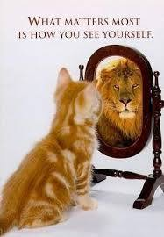
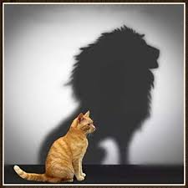

Slide 11
Three Divisions of Self-Image
Physical - perception based on outward appearances
Emotional - perception according to emotional characteristics
Intellectual - perception based upon our educational successes and failures

Slide 12
Passion
Continued Learning
Adaptability
Ambition

Slide 13
Positive Factors of Self-Image
Family
Friends
Mentors
coaches, teachers, religious leaders
Accomplishments
Successes

Slide 14
Negative Factors of Self-Image
Advertisements
Media
television, movies, magazines
Peers
Personal Failures
Destructive or Damaging Experiences

Slide 15
Four Ways to Promote Positive Self-Image
Build upon your successes
Celebrate your successes
Engage in activities that stem from successes to increase your level of challenge

Slide 16
Four Ways to Promote Positive Self-Image
Concentrate on your possibilities rather than your limitations
Find ways to use your talents and interests

Slide 17
Four Ways to Promote Positive Self-Image
Set goals
Set attainable goals to subtly change the factors you are unhappy with
Build-up the self-image of others
Practice giving positive compliments to others each day
Avoid making unconstructive and critical comments to others

Slide 18
Question and Answer Session
Q & A

Slide 19
What we will cover next
Networking

